Slide 1
Green Schools Erasmus+ Project
Partner meeting in Belgrade, 17.03.2022

Slide 2
Main topics to be covered
Objectives
Main results expected
Presentation of Methodology
Tasks for the next 6 months

Slide 3
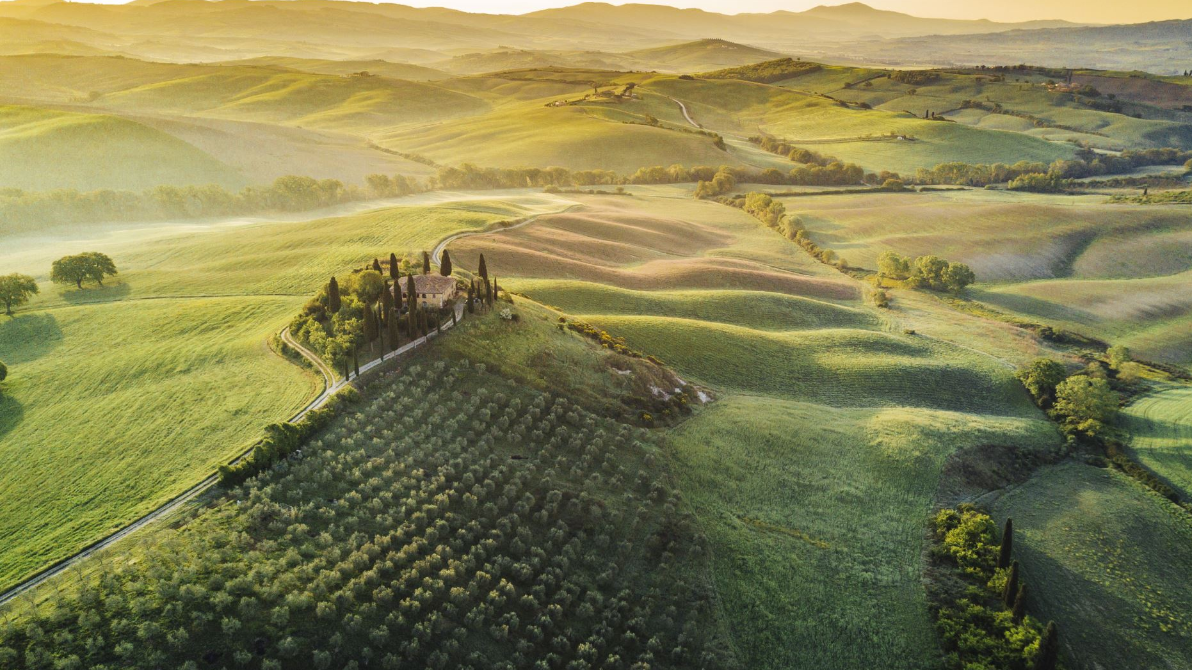
Objectives
Support primary teachers in providing quality environmental education in line with EC Green Deal and the UN Sustainable Development Goals.
Development of environmental literacy among the younger generations.
Support schools in implementing the concept of "green schools“.

Slide 4
Main results expected
Methodology for organising and implementing a short qualification course for primary teachers in ecological education
30 primary teachers trained (10 per country)
750 pupils engaged in ecological education activities, as a result of the training (250 per partner country)
More than 5000 stakeholders from the three partner countries will be reached
The project will improve the quality of ecological education at primary education level
In the long-term this effect will contribute to fostering eco-systemic awareness and proactive environmental citizenship in learners

Slide 5
Project timeline
 |  | Jan | Feb | Mar | Apr | May | Jun | Jul | Aug | Sep | Oct | Nov | Dec | Jan | Feb | Mar | Apr | May | Jun | Responsible partner
Project activity*
Work stream 1 - Management |  | 1 | 2 | 3 | 4 | 5 | 6 | 7 | 8 | 9 | 10 | 11 | 12 | 13 | 14 | 15 | 16 | 17 | 18
Tasks allocation, monitoring and control |  |  |  |  |  |  |  |  |  |  |  |  |  |  |  |  |  |  |  | SBU (BG)
M1 - Kick-off project meeting, Belgrade (RS) |  | TPM |  |  |  |  |  |  |  |  |  |  |  |  |  |  |  |  |  | TUS (SR)
M2 - Second project meeting, Sofia (BG) |  |  |  |  |  |  |  |  |  |  | TPM |  |  |  |  |  |  |  |  | SBU (BG)
M3 - Final project meeting, Bucharest (RO) |  |  |  |  |  |  |  |  |  |  |  |  |  |  |  |  |  |  | TPM | FSLI (RO)
Progress reports |  |  |  |  |  |  |  | PR |  |  |  |  |  | PR |  |  |  |  | PR | ALL
Final report |  |  |  |  |  |  |  |  |  |  |  |  |  |  |  |  |  |  | FR (prep) | ALL
Work stream 2 - Development of R1 (Methodology for organising and implementing a short qualification course for primary teachers in ecological education) |  | 1 | 2 | 3 | 4 | 5 | 6 | 7 | 8 | 9 | 10 | 11 | 12 | 13 | 14 | 15 | 16 | 17 | 18
Content structure development in EN |  |  |  |  |  |  |  |  |  |  |  |  |  |  |  |  |  |  |  | SBU with inputs from TUS and FSLI
Validation of content (research group and additional scientific research) |  |  |  |  |  |  |  |  |  |  |  |  |  |  |  |  |  |  |  | SBU with inputs from TUS and FSLI
Development of content in EN and translation in partner languages (BG, RO and SR) |  |  |  |  |  |  |  |  |  |  |  |  |  |  |  |  |  |  |  | SBU with inputs from TUS and FSLI
Training 30 primary teachers (10 teachers per country) |  |  |  |  |  |  |  |  |  |  |  |  |  |  |  |  |  |  |  | FSLI with inputs from SBU and TUS
Piloting with 750 pupils (250 per per country) |  |  |  |  |  |  |  |  |  |  |  |  |  |  |  |  |  |  |  | TUS with inputs from SBU and FSLI
Evaluation of piloting data, fine-tuning and official publishing |  |  |  |  |  |  |  |  |  |  |  |  |  |  |  |  |  |  |  | SBU with inputs from TUS and FSLI
Work stream 3 - Promotion and shaing
Set-up and maintain a project page in Facebook |  |  |  |  |  |  |  |  |  |  |  |  |  |  |  |  |  |  |  | FSLI (RO)
Set-up visual identity |  |  |  |  |  |  |  |  |  |  |  |  |  |  |  |  |  |  |  | FSLI (RO)
Produce and publish info items (30 items) |  |  |  |  |  |  |  |  |  |  |  |  |  |  |  |  |  |  |  | ALL
Participation in thematic events with 15 presentations (5 per partner) |  |  |  |  |  |  |  |  |  |  |  |  |  |  |  |  |  |  |  | ALL
Meetings with stakeholders |  |  |  |  |  |  |  |  |  |  |  |  |  |  |  |  |  |  |  | ALL
E1 - Final conference, Sofia (BG) |  |  |  |  |  |  |  |  |  |  |  |  |  |  |  | Preparation |  |  |  | SBU (BG)

Slide 6
Methodology for organising and implementing a short qualification course for primary teachers in ecological education (IO1) – Concept
The aim of the Green School methodology is to provide concrete and clear guidelines to organise and implement training course for primary teachers in ecological education. Min. 100 pages (excluding bibliography). It will be available in EN and all partner languages.
The methodology will also contain a teacher’s book, which the trained teachers can use, when planning, organizing and implementing training on the topics addressed in their classrooms.

Slide 7
Methodology for organising and implementing a short qualification course for primary teachers in ecological education (IO1) – Concept
Thematic training content to be delivered in the training course, emphasising on Green Deal priority, UN goals for sustainable development and the shift from the paradigm of recycling to the concept of zero waste.
Thematic training methods and practical activities to be presented to primary teachers. These methods will focus on engaging pupils in practical/experiential activities, which foster their ecological awareness and environment citizenship skills.
Training guidelines for providers of courses to teachers with a sample course structure in line with national legislative frameworks.
Special chapter on the concept of Green Schools “going beyond the classroom activities”. Inspired by Green Schools model from Ireland (https://greenschoolsireland.org/)

Slide 8
Methodology for organising and implementing a short qualification course for primary teachers in ecological education (IO1) – Tasks
April-May 2022 Tasks
Validation of concept (research group and additional desk research)
BG sends research questions and instructions for focus groups
Partners prepare national reports with findings, including sources that can be used for drafting the methodology
BG partner consolidates findings and makes changes to the structure of the methodology, if needed
BG partner will distribute development (writing tasks) to all partners. For example:
FLSI - chapter on teaching methods
TUS - chapter on ecological education
SBU - chapter with guidelines for course providers and the Green Schools concept.

Slide 9
Tasks for 6 months (up to Sep2022)
SBU (BG) | TUS (RS) | FLSI (RO)
1st payments to be made Send instructions for research groups and desk research Conduct national research Consolidate national reports Assign development tasks Start working on content development | Conduct national research groups and desk research Prepare national report Work on concrete content development | Conduct national research groups and desk research Prepare national report Work on concrete content development Promotion and sharing: Facebook page of the project, publishing news items in cooperation with other partners

Slide 10
Open discussion

